Slide 1
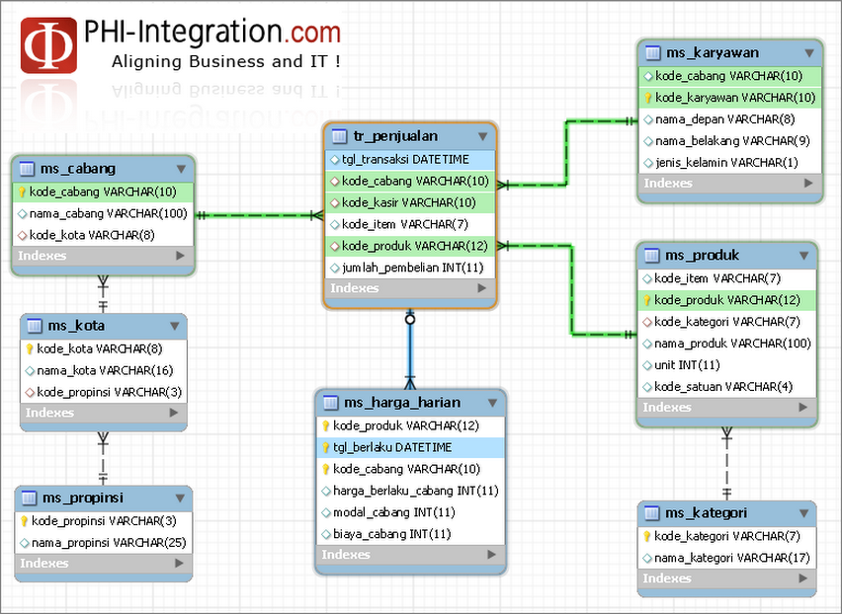
OLTP
Notes:
<number>

Slide 2
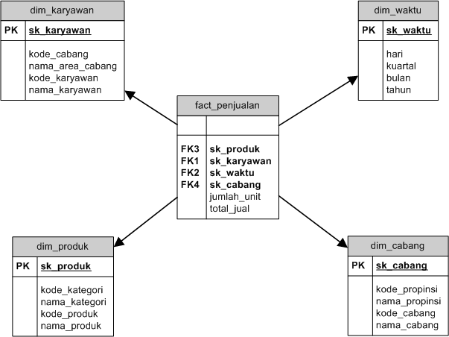
Star Schema

